Slide 1
Virtual Machines and Virtualization Middleware

Slide 2
A virtual machine is an application environment, that is installed on software, which imitates dedicated hardware.
A virtual machine is virtual environment that function as a virtual computer system with its own cpu, memory, storage and network interfaces created on a physical hardware system
Software called a hypervisor, separate the machine resources from hardware, so they can be used by the VM.
The end user has the same experience on a virtual machines they would have on dedicated hardware.

Slide 3
Need for VM
Conventional computer has Single OS image .
Rigid architecture that tightly couples application software to a specific hardware platform .
Software compatible with one machine may not be compatible with another platform with a different instruction set under a fixed OS.

Slide 4
Virtual machines (VMs) offer novel solutions for:
Underutilized resources
Application inflexibility
Software manageability and
Security concerns in existing physical machines

Slide 5
To build large clusters, grids and clouds we need to access large amount of computing, storage, and networking resources in a virtualized manner.
We need to aggregate those resources ,to offer a single system image.
A cloud of provisional resources must depend on virtualization of processors, memory, i/o facilities dynamically.

Slide 6
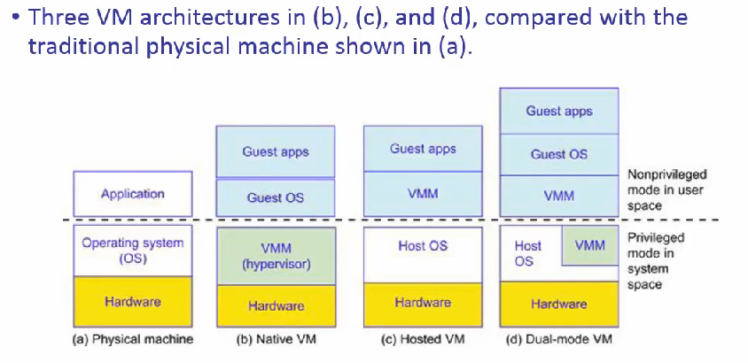
Virtual Machines

Slide 7
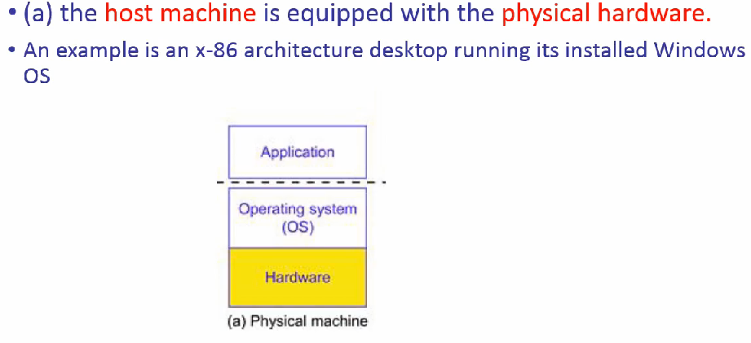
Physical machines

Slide 8
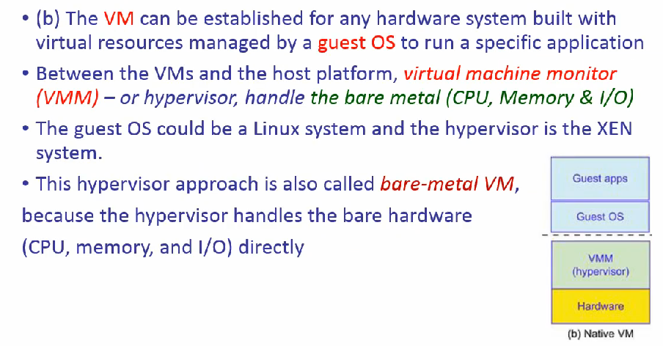
Native VM

Slide 9
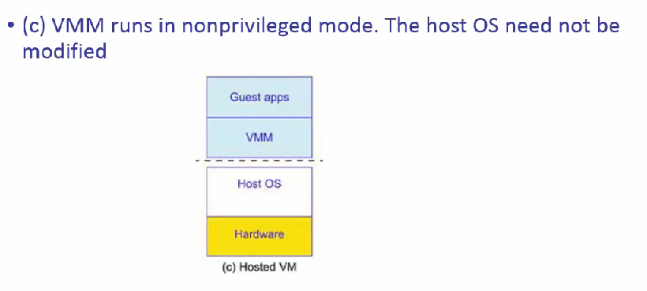
Hosted VM

Slide 10
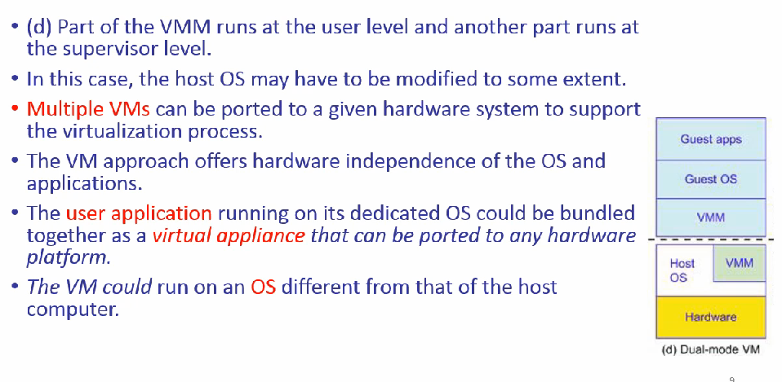
Dual mode VM

Slide 11
Advantages
Multiple VMs can be ported to a given hardware system to support the virtualization process.
Offers hardware independence of the OS and applications.
The user application running on its dedicated OS could be bundled together as a virtual appliance that can be ported to any hardware platform.
The VM could run on an OS different from that of the host computer

Slide 12
VM Primitive Operations
VMM provides the VM abstraction to the guest OS.
With full virtualization, the VMM exports a VM abstraction identical to the physical machine .
The primitive operations are Multiplexing, suspension, provision and migration.

Slide 13
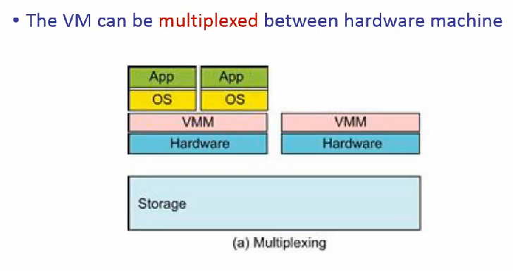
Vm multiplexing

Slide 14
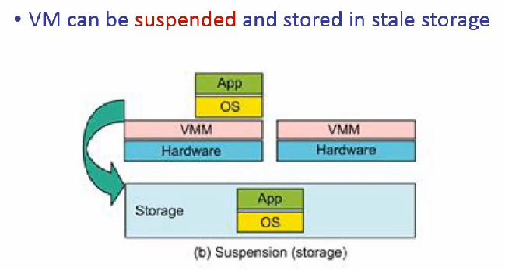
Suspension(storage)

Slide 15
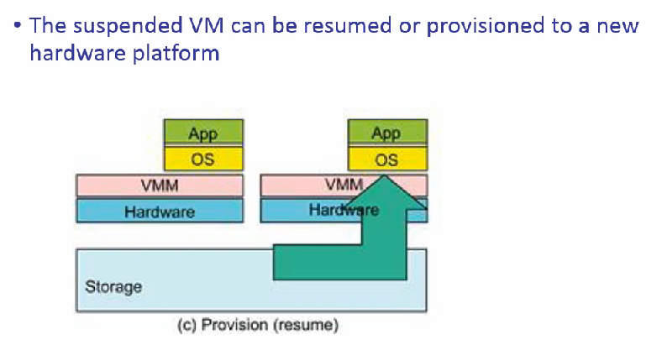
Provision(resume)

Slide 16
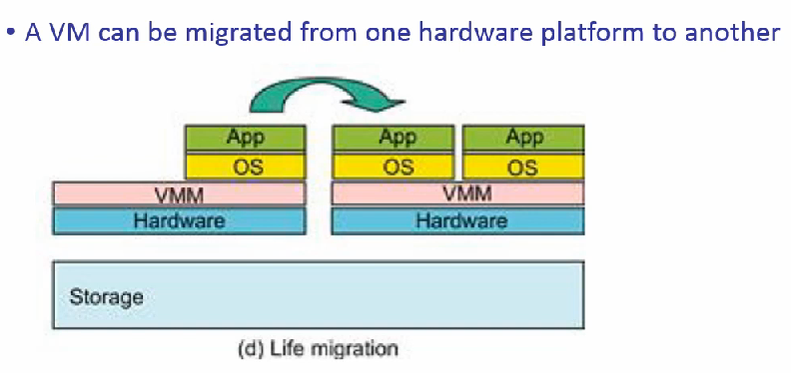
Life migration

Slide 17
These operations enable a VM to be provisioned to any available hardware platform.
Enable flexibility in porting distributed application executions.
Enhance the utilization of server resources.
Multiple server functions can be consolidated on the same hardware platform to achieve higher system efficiency.

Slide 18
VM migration
The process of moving a running VM or application between different physical machines without disconnecting the client or application.
Memory, storage and network connectivity of the VM are transferred from one original guest machine to the destination machine.

